Slide 1
Introduction to Deep Networks
Part 3

Slide 2

Neural Networks

Slide 3
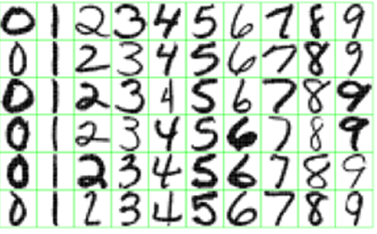
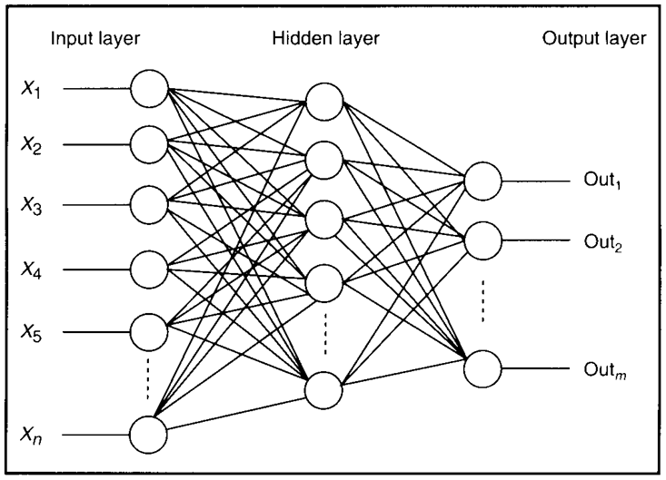
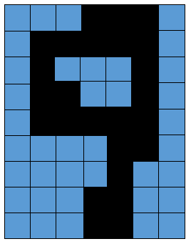
Feature Detectors

Slide 4
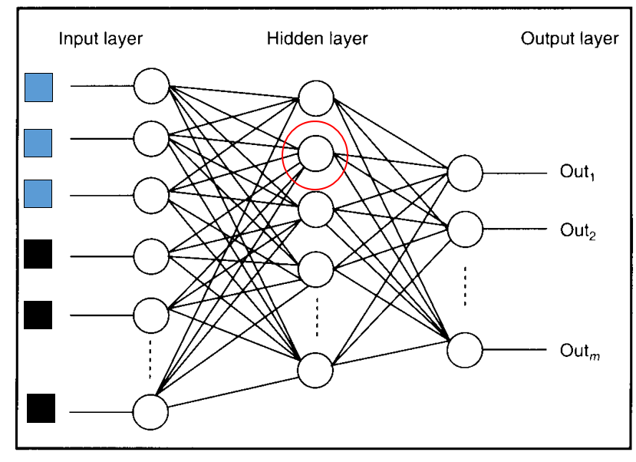
What Is This Unit Doing?

Slide 5
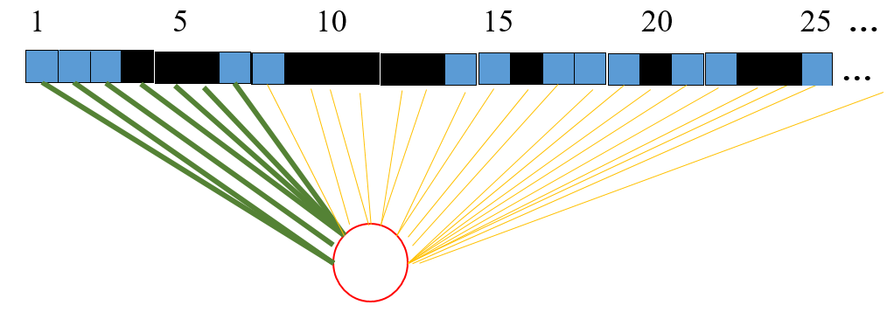
Hidden Layer Units Become Self-Organised Feature Detectors

Slide 6
What Does This Unit Detect?
strong +ve weight
low/zero weight
Strong signal for a horizontal line in the top row,
ignoring everywhere else

Slide 7
What features might you expect a good NN
to learn, when trained with data like this?

Slide 8
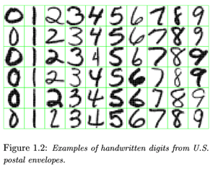
vertical lines

Slide 9
Horizontal lines
63

Slide 10
Small circles
63

Slide 11
Small circles
But what about position invariance ???
our example unit detectors were tied to
specific parts of the image
63

Slide 12
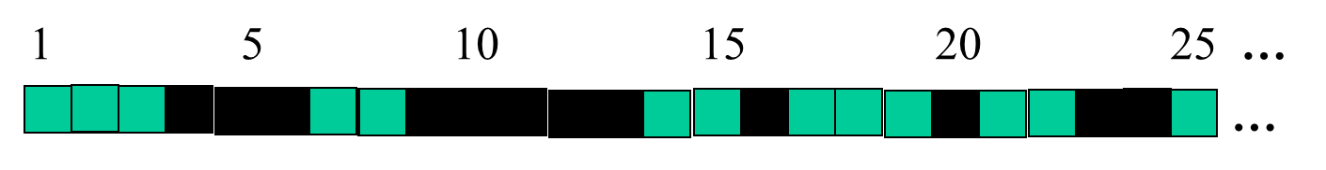
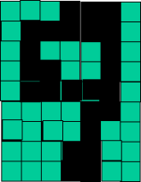
Successive Layers Can Learn Higher-Level Features
Detect lines in specific positions
etc …
Higher level detectors
( horizontal line,
“RHS vertical lune”
“upper loop”, etc…
etc …
v

Slide 13
Multiple Layers Make Sense

Slide 14
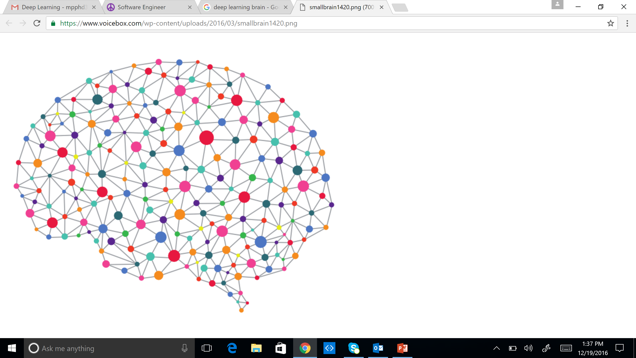
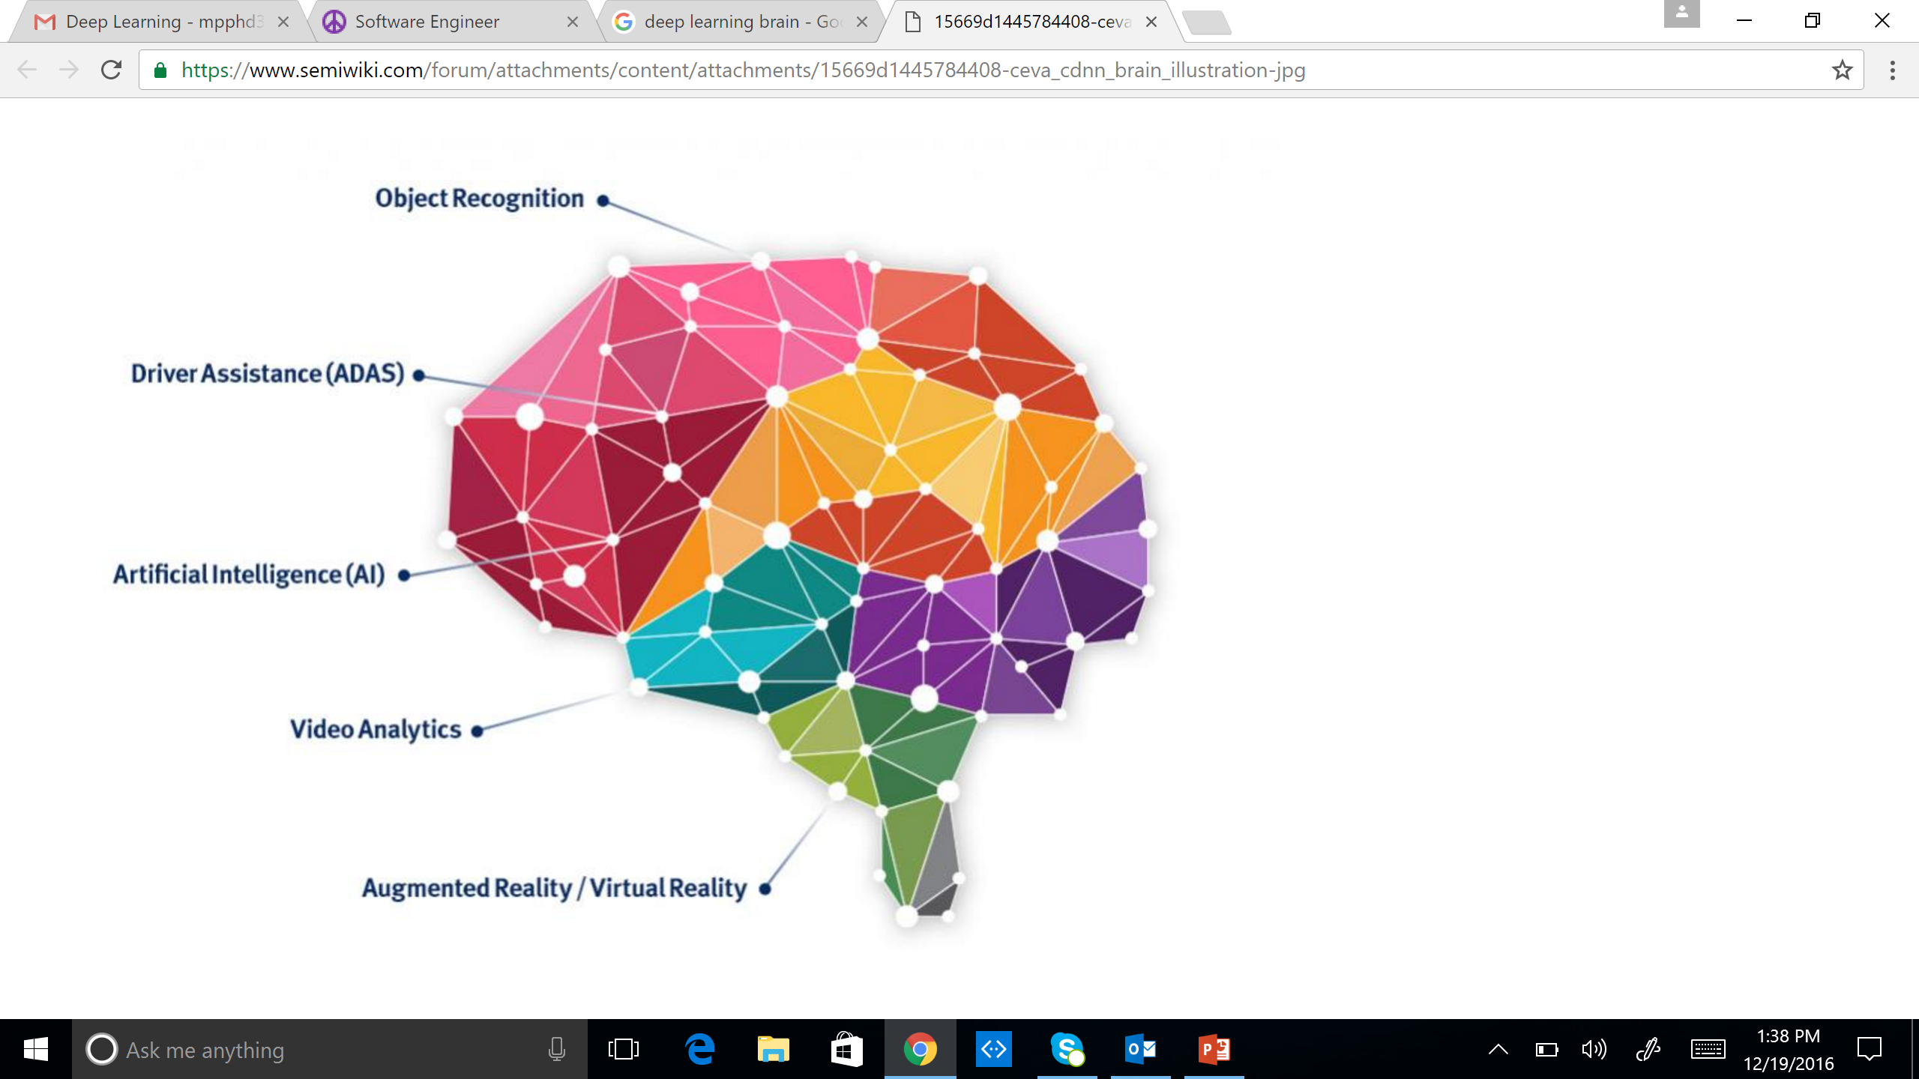
Multiple Layers Make Sense
Deep Learning = Brain “inspired”
Audio / Visual Cortex has multiple stages = Hierarchical

Slide 15
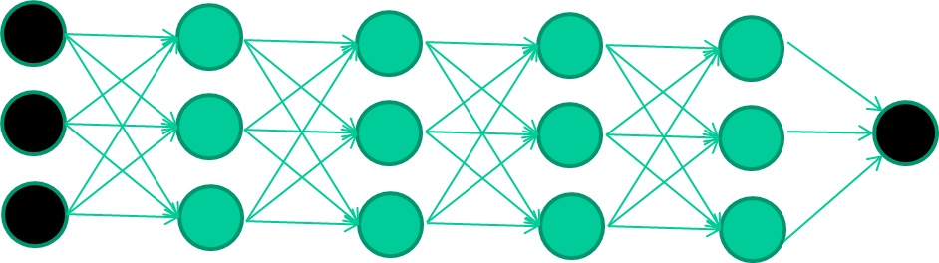
Multiple Layers Make Sense
Many-layer neural network architectures should be capable of learning the true underlying features and ‘feature logic’, and therefore generalise very well …

Slide 16
The New Way To Train Multi-Layer NNs…

Slide 17
The New Way To Train Multi-Layer NNs…
Train this layer first

Slide 18
The New Way To Train Multi-Layer NNs…
Train this layer first
then this layer

Slide 19
The New Way To Train Multi-Layer NNs…
Train this layer first
then this layer
then this layer

Slide 20
The New Way To Train Multi-Layer NNs…
Train this layer first
then this layer
then this layer
then this layer

Slide 21
The New Way To Train Multi-Layer NNs…
Train this layer first
then this layer
then this layer
then this layer
finally this layer

Slide 22
The New Way To Train Multi-Layer NNs…
Each layer can be thought of as a set of features

Slide 23
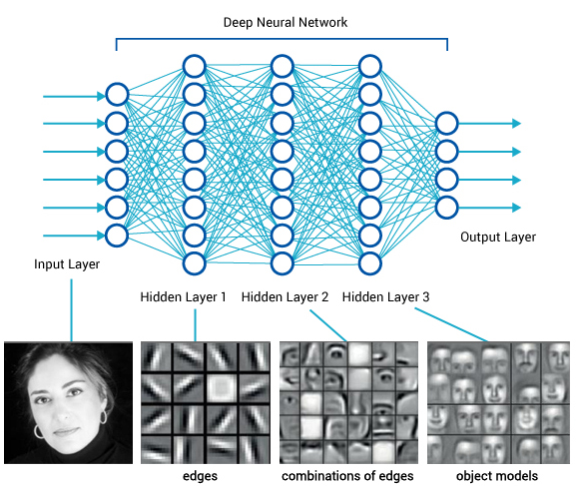
Idea Behind Deep Learning
There are many types of deep learning
Different kinds of autoencoder, variations on architectures and training algorithms, etc.
It’s a growing area

Slide 24
Common DNNs
Deep Convolutional Neural Network (DCNN)
To extract representation from images
Recurrent Neural Network (RNN)
To extract representation from sequential data
Deep Belief Neural Network (DBN)
To extract hierarchical representation from a dataset
Deep Reinforcement Learning (DQN)
To prescribe how agents should act in an environment in order to maximize future cumulative reward (e.g., a game score)
We will cover DCNN today

Slide 25
Open Source Deep Learning Frameworks
DL4J
JVM-based
Distrubted
Integrates with Hadoop and Spark
Theano
Very popular in Academia
Fairly low level
Interfaced with via Python and Numpy
Torch
Lua based
In house versions used by Facebook and Twitter
Contains pretrained models

Slide 26
Open Source Deep Learning Frameworks
TensorFlow
Google written successor to Theano
Interfaced with via Python and Numpy
Highly parallel
Can be somewhat slow for certain problem sets
Caffe
Not general purpose. Focuses on machine-vision problems
Implemented in C++ and is very fast
Not easily extensible
Has a Python interface

Slide 27
Deep Learning And Computer Vision

Slide 28
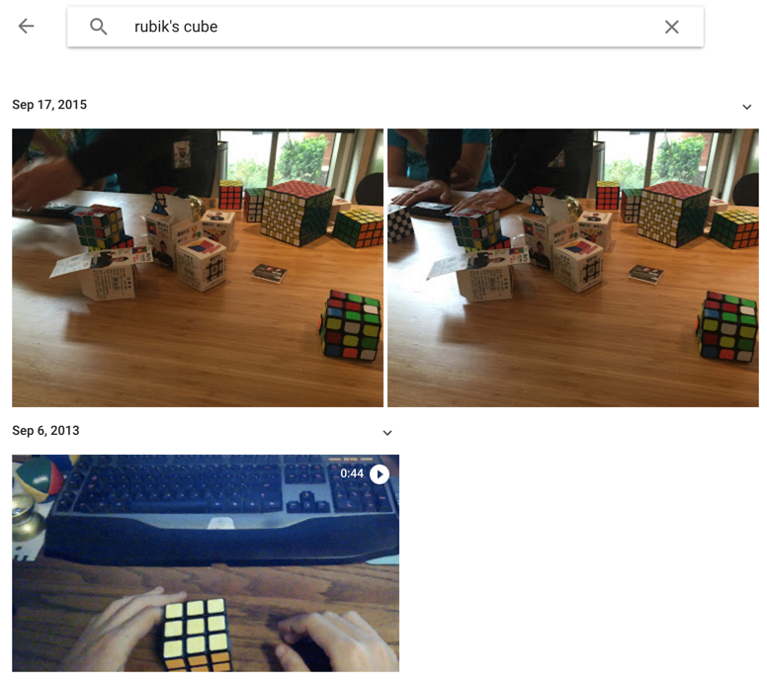
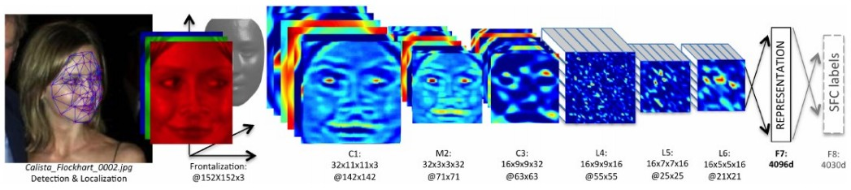
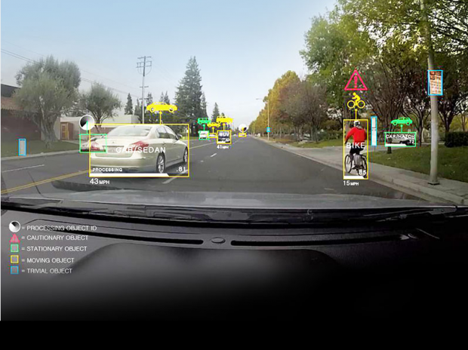
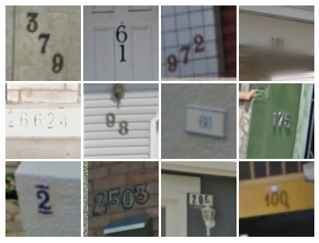
ConvNet
Face Verification, Taigman et al. 2014 (FAIR)
e.g. Google Photos search
[Goodfellow et al. 2014]
Self-driving cars

Slide 29
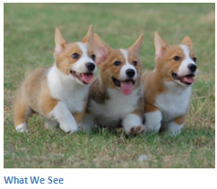
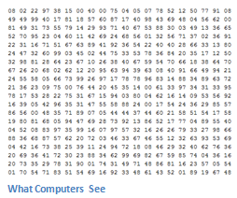
Image Classification
Task of taking an input image and outputting a class
Probability of classes that best describes the image
For humans, effortless task

Slide 30
Input Image
An image is an an array of pixel values
A JPG color image with size 480 x 480:
The representative array will be 480 x 480 x 3. Each number is given a value from 0 to 255 which is the pixel intensity
Grey scale image contains a single sample (intensity value) for each pixel
Image Classification:
Given an array of numbers, produce probabilities of the image being a certain class

Slide 31
Convolutional Neural Networks
Three basic ideas:
Local receptive fields
Shared weights
Pooling

Slide 32
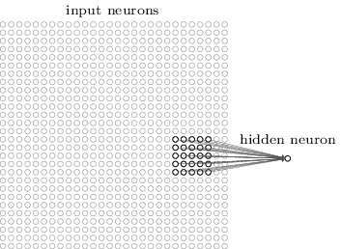
Local Receptive Fields
Connections are from small, localized regions of the input image to hidden layers
A little window on the input pixels
Each neuron in the first hidden layer is connected to a small region of the input neurons. For example, a 5x5 region

Slide 33
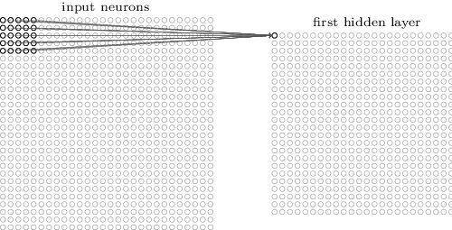
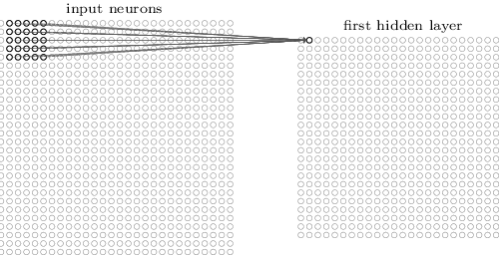
Local Receptive Fields

Slide 34
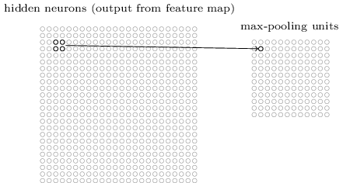
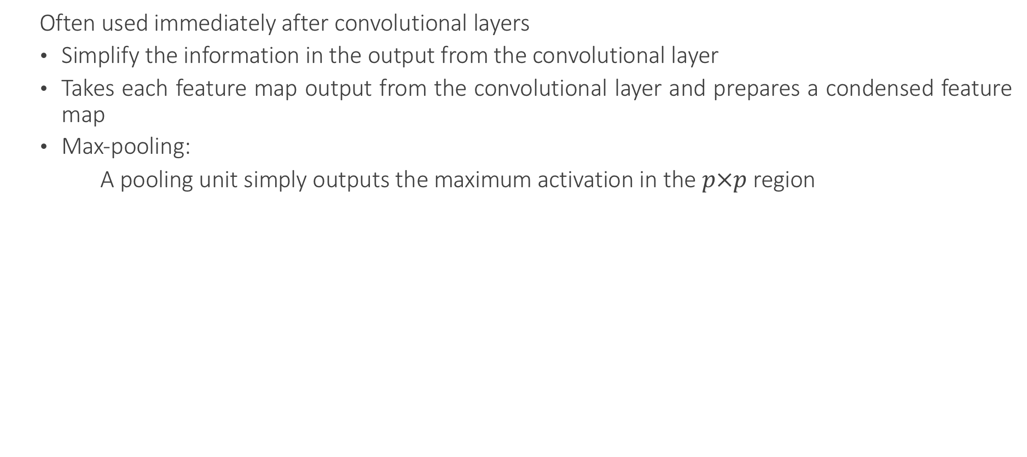
Pooling Layers
Often used immediately after convolutional layers
Simplify the information in the output from the convolutional layer
Takes each feature map output from the convolutional layer and prepares a condensed feature map
Max-pooling:
A pooling unit simply outputs the maximum activation in the $p×p$ region

Slide 35
Max Pooling
Single depth slice
1 | 1 | 2 | 4
5 | 6 | 7 | 8
3 | 2 | 1 | 0
1 | 2 | 3 | 4
x
max pool with 2x2 filters and stride 2
6 | 8
3 | 4
y

Slide 36

Pooling Layers
Smaller representations and more manageable
Operates over each activation map independently

Slide 37
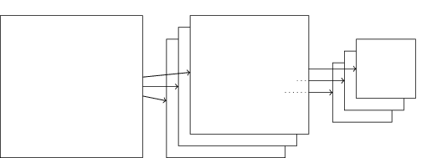
Pooling Layers
Combined convolutional and max-pooling layers:

Slide 38
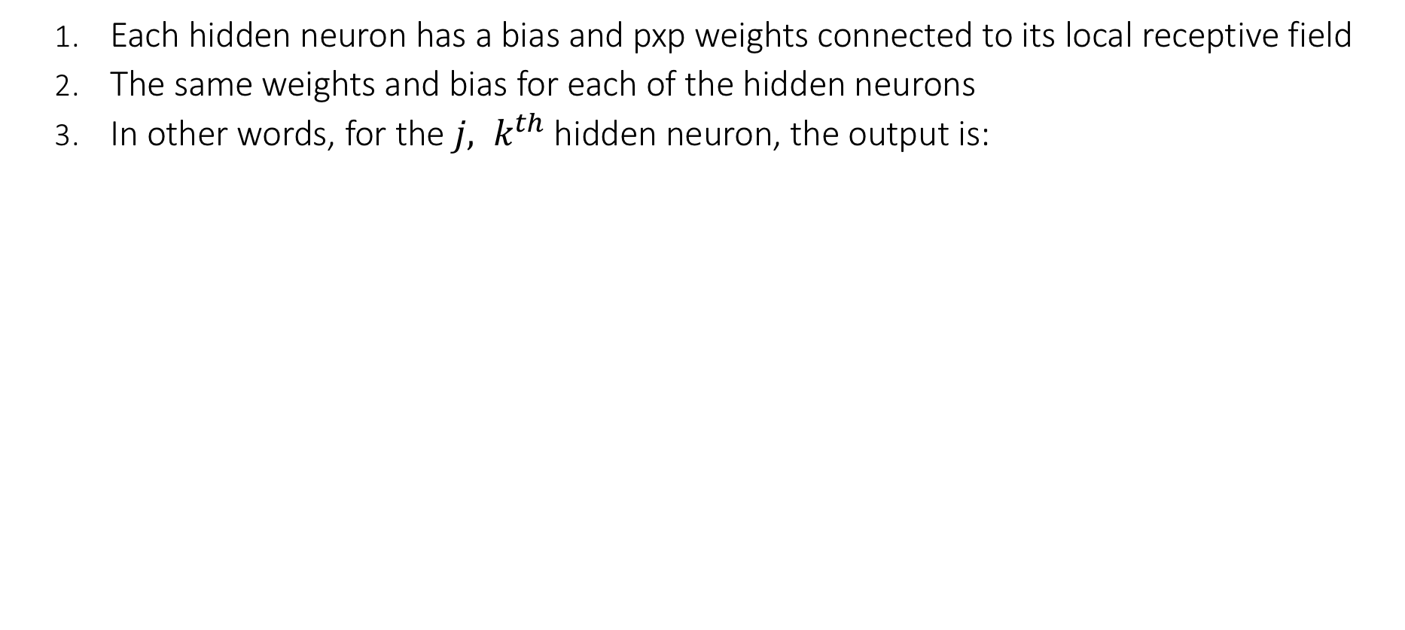
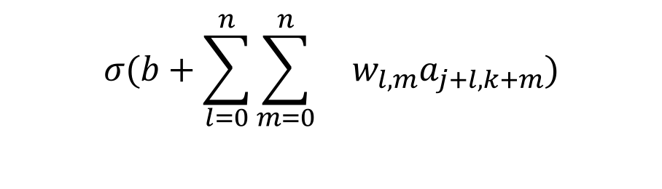
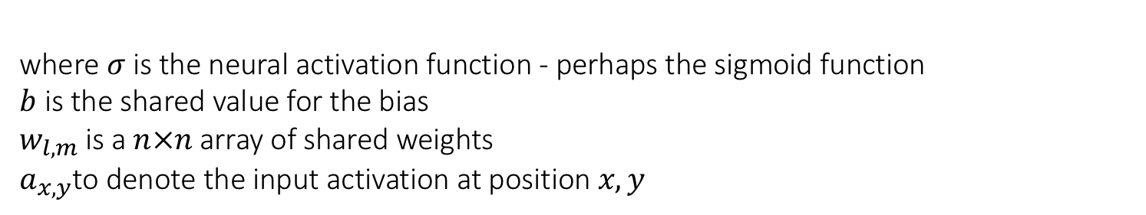
Shared Weights And Biases
Each hidden neuron has a bias and pxp weights connected to its local receptive field
The same weights and bias for each of the hidden neurons
In other words, for the ${j, k}^{th}$ hidden neuron, the output is:
$$σ(b+\sum_{l=0}^{n}{\sum_{m=0}^{n}{ w_{l,m}a_{j+l,k+m})}}$$
where $σ$is the neural activation function - perhaps the sigmoid function
$b$is the shared value for the bias
$w_{l,m}$is a $n×n$array of shared weights $a_{x,y}$to denote the input activation at position $x, y$

Slide 39
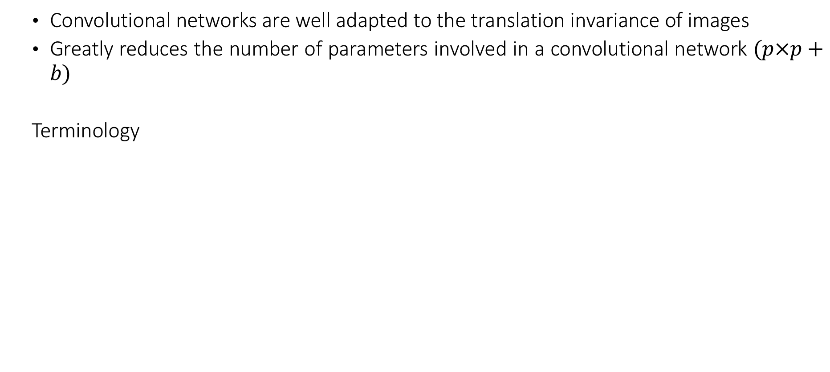
Shared Weights And Biases
Convolutional networks are well adapted to the translation invariance of images
Greatly reduces the number of parameters involved in a convolutional network $(p×p+b)$
Terminology
Feature map/Activation map | Map from the input layer to the hidden layer
Shared weights | Weights defining the feature map
Shared bias | Bias defining the feature map
Kernel/Filter | Shared weights and bias

Slide 40
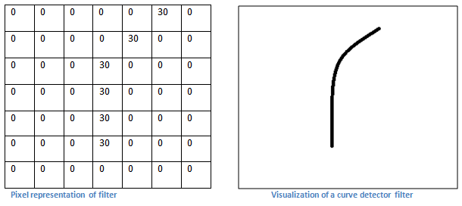
First Layer – High Level Perspective
Filters can be thought of as feature identifiers (straight edges, simple colors, and curves)
In the simple case of a one filter convolution and a curve detector filter, activation map results in regions that are most likely curves in the picture
More filters mean greater the depth of the activation map
This results in more information about the input

Slide 41
Going Deeper Through The Network
Many layers are interspersed between convolution layers (example: ReLu and Dropout)
Introduction of nonlinearities
Improve the robustness of the network and control overfitting

Slide 42
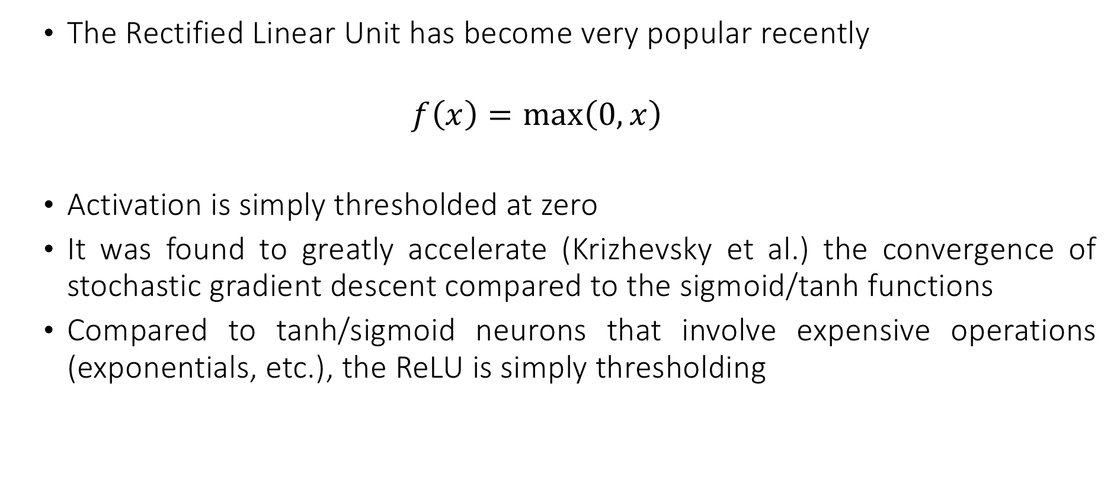
RelU
The Rectified Linear Unit has become very popular recently
$$f\left(x\right)=\max\left(0,x\right)$$
Activation is simply thresholded at zero
It was found to greatly accelerate (Krizhevsky et al.) the convergence of stochastic gradient descent compared to the sigmoid/tanh functions
Compared to tanh/sigmoid neurons that involve expensive operations (exponentials, etc.), the ReLU is simply thresholding

Slide 43
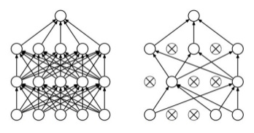
Dropout
A form of ensemble learning
Avoids overfitting (by preventing inter-dependencies from emerging between nodes)
Dropout - an extreme version of bagging
At each training step, the dropout procedure creates a different network by removing some neurons randomly

Slide 44

Fully Connected Layer (FC layer)

Slide 45
Deep Learning And NLP

Slide 46
CNNs for NLP
CNNs were responsible for major breakthroughs in Image Classification and are the core of most Computer Vision systems today, from Facebook’s automated photo tagging to self-driving cars.
More recently, CNNs are also applied to problems in Natural Language Processing.
The intuitions behind CNNs are easier to understand for the Computer Vision use case.

Slide 47
CNNs for NLP
Instead of image pixels, the input to most NLP tasks are sentences or documents represented as a matrix.
Each row of the matrix corresponds to one token, typically a word, but it could be a character. That is, each row is vector that represents a word.
Typically, these vectors are word embeddings, but they could also be one-hot vectors that index the word into a vocabulary.
For a 10 word sentence using a 100-dimensional embedding we would have a 10×100 matrix as our input. That’s our “image”.

Slide 48
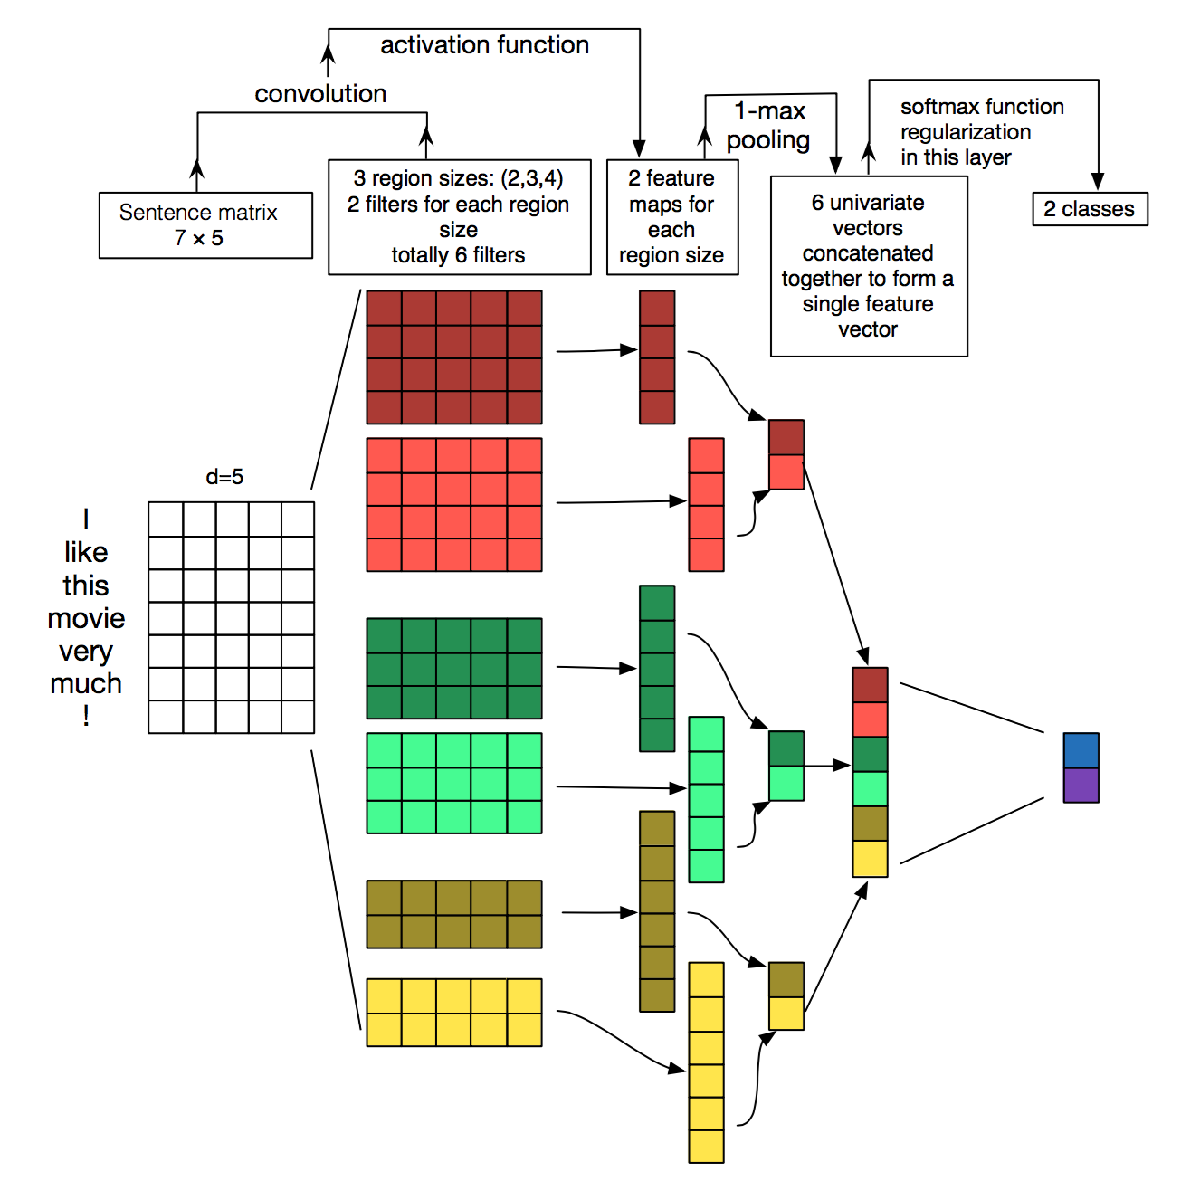
CNNs for NLP
In vision, filters slide over local patches of an image, but in NLP, filters slide over full rows of the matrix (words).
The height, or region size, may vary, but sliding windows over 2-5 words at a time is typical.
Example of Convolutional Neural Network for NLP:

Slide 49
What about the nice intuitions we had for Computer Vision?
With text, you probably do care a lot where in the sentence a word appears.
Pixels close to each other are likely to be semantically related (part of the same object), but the same isn’t always true for words.
In many languages, parts of phrases could be separated by several other words.
Words compose in many ways: an adjective modifying a noun, but how exactly this works and what higher level representations actually “mean” isn’t as obvious as in the Computer Vision case.

Slide 50
What about the nice intuitions we had for Computer Vision?
Given all this, it seems like CNNs wouldn’t be a good fit for NLP tasks.
Recurrent Neural Networks make more intuitive sense. The are similar to how we process language: Reading sequentially from left to right.
Fortunately, this doesn’t mean that CNNs don’t work.

Slide 51
CNNs work for NLP!
The simple Bag of Words model is an obvious oversimplification and can lead to pretty good results.
A big argument for CNNs is that they are fast. Very fast.
Convolutions are a central part of computer graphics and typically, implemented on GPUs.
Compared to something like n-grams, CNNs are efficient with representation. With a large vocabulary, computing anything more than 3-grams can quickly become expensive.
Even Google doesn’t provide anything beyond 5-grams. Convolutional Filters learn good representations automatically, without needing to represent the whole vocabulary.
Possibly, many of the learned filters in the first layer capture feature similar to n-grams, but represent them in a more compact way.

